Slide 1
Topics to be covered
Why we need to do numerical integration?
Deterministic vs. stochastic methods of integration
Examples of deterministic methods: Rectangular, trapezoidal, etc. and their limitations
Random nos., random no generators, testing of random numbers
Monte Carlo (MC) integration:
Introduction to MC integration
Errors in MC integration
Improvement of MC integration
Hit & miss/ Acceptance & rejection method
Change of variables
Importance sampling
Multi dimensional integration using MC.

Slide 17
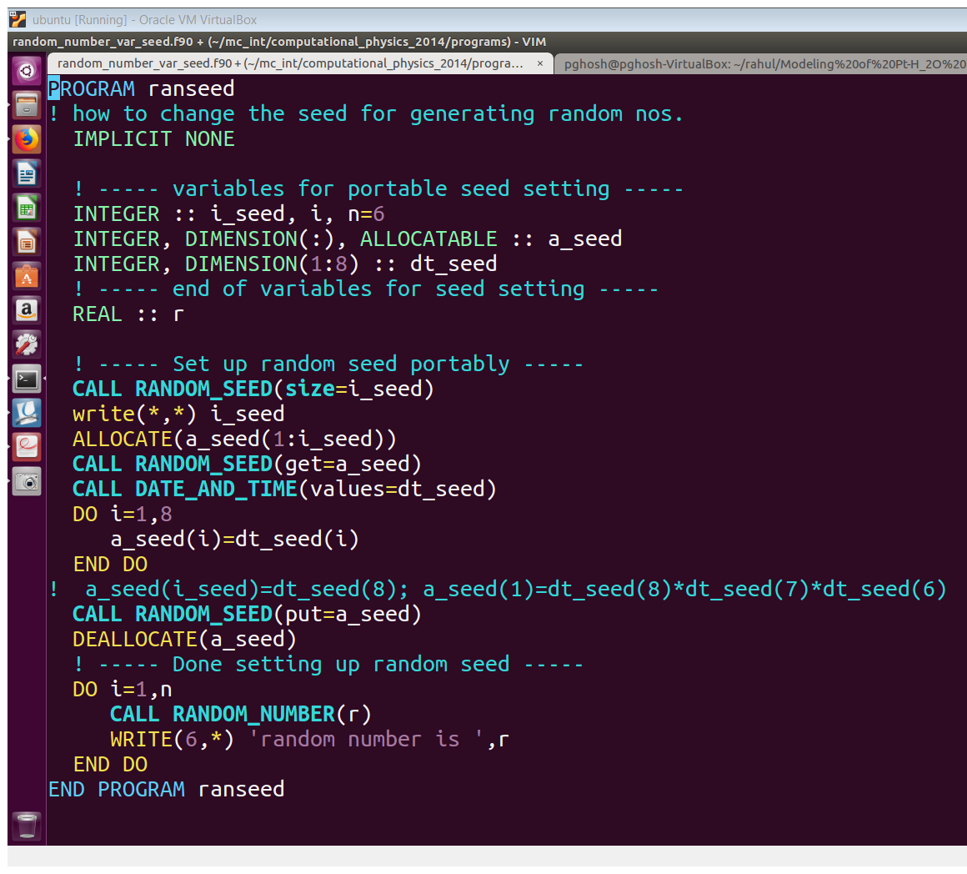
Usage of RANDOM NUMBER generator in Fortran

Slide 18
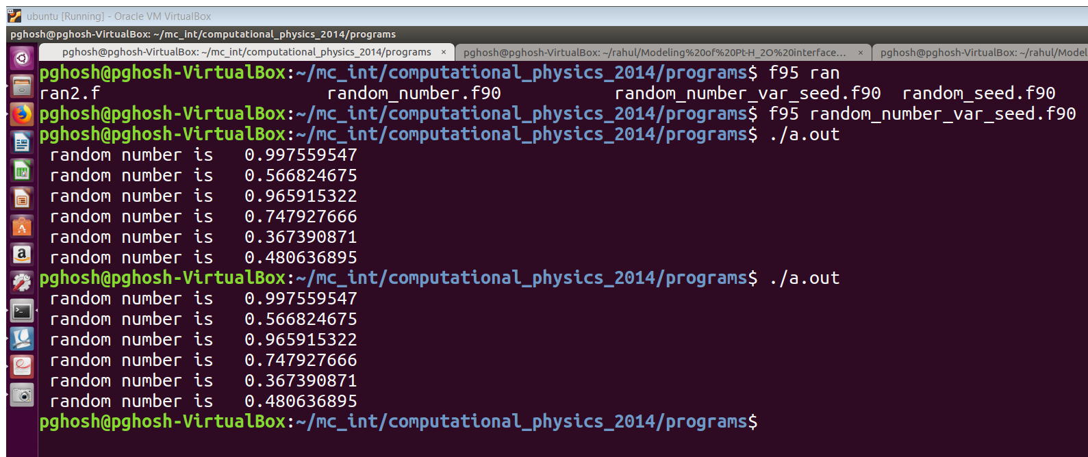
Usage of RANDOM NUMBER generator in Fortran

Slide 19
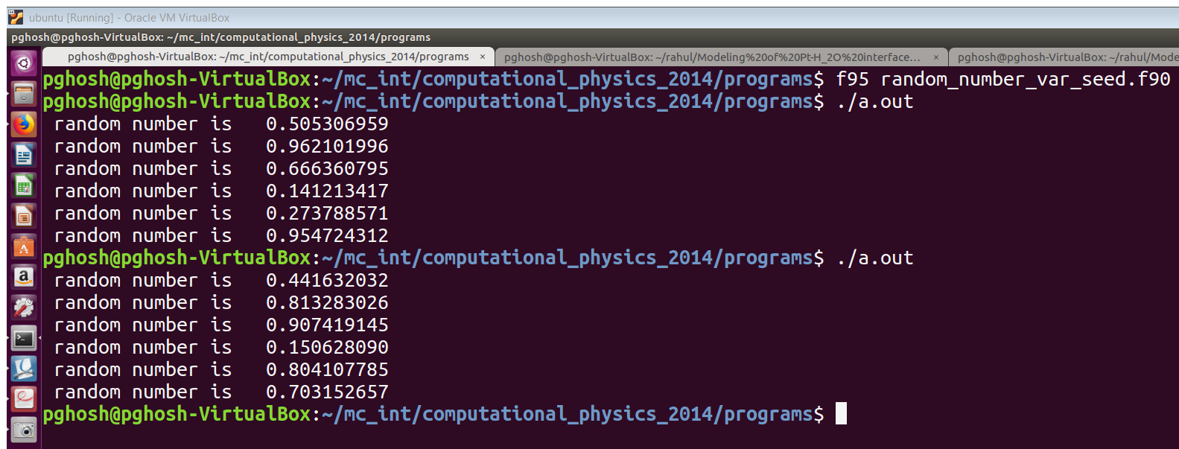
Usage of RANDOM NUMBER generator in Fortran

